Slide 1
Mental health in the it workplace
LEROY MASWAURE 1710240005
AKWOLU MBAMALU FESTUS 1712150010
AUNG KYAW MOE 180110007
ITE351 PROGRAMMING FOR DATA SCIENCE

Slide 2
WHY EXAMINE MENTAL HEALTH IN THE IT WORKPLACE? And data source
There a lot of costs involved in ignoring mental health issues in the IT workplace because it can reduce efficiency of employees
To know the number of people in the workplace who suffer from mental health issues
Our data came from Open Sourcing mental illness LTD where they carried out a survey in the IT industry looking at factors such as family history of each participant, age, health care benefits to see if it contributed to the employees into seeking treatment.

Slide 3
Hypothesis
We had a lot of hypothesis regarding what would make an employee seek treatment and they are as follows
Which gender is more likely to seek mental health treatment
Does family history cause participants to seek mental health issues
Can work interference mean that a person has mental health issues and does that interference cause them to seek treatment
Predicting if employees should get mental health treatment based on mental health history, work performance, age and gender combined.

Slide 4
Type of analysis used
We had a lot of analysis in terms of visualization
Cleaning the data in age as it had outliers
Grouping gender into 3 main genders such as male, female and trans since we had a lot of genders in the survey
We managed to find out that more males seek mental health treatment than all other genders
Checking prediction of our main variables using confusion matrix

Slide 5
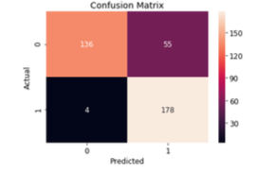
COnfusion MATRIX

Slide 6
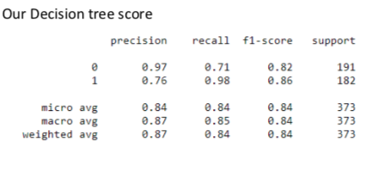
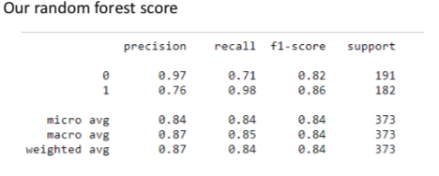
ALGORITHMS AND SCORES
DECISION TREE
RANDOM FOREST

Slide 7
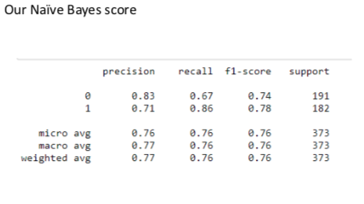
NAÏVE BAYES

Slide 8
CONCLUSION AND RECOMMENDATION
The mental health of employees in the workplace is important because it can affect their moral and productivity in. the IT industry where innovation is in need. The workplace should provide employees with monthly mental health care benefits and checkups

